Slide 1

Online Grocery Shopping System
Submitted By :
Riya Chhillar
Himanshu Kumar
Sumit Mukherjee
Subhadip Chakraborty
Srijani Chatterjee

Slide 2
OVERVIEW
Introduction
Requirements
Feasibility Study
Screenshots
Applications of the Project
Future Scope and References
Conclusion

Slide 3
Introduction
The parameters of online shopping have expanded to groceries over the last five years. And the response people have shown gives Indian ecommerce yet another victory. The fact that grocery goods do not always need to be tried or felt before buying makes this category of online business so amazing. The biggest advantage is people do not need to exit their homes to buy groceries with online shopping services.
Objective:
Online Grocery Shopping solution to consumers.
Users can order products from anyplace at anytime.
The users security is our primary concern. No unauthorized user can have access.

Slide 4
Database Tables
User Table
USER_ID | NAME | EMAIL | CONTACT | USERNAME | PASSWORD
 |  |  |  | (Primary Key)
Product Table
PROD_ID | CATEGORY | DESCRIPTION | STOCK | PRICE
(Primary Key)
Booking Table
ORDER_ID | PROD_ID | QUATITY | BILLING_ADD | USER_ID
(Primary Key)

Slide 5
Software Requirements
OS: Windows 10
Database: Oracle
IDE: Spring Tools Suite, Spring Boot
Server: Tomcat
Front End: HTML, CSS, Bootstrap
Back End: Java

Slide 6
Feasibility Study
Technical Feasibility:
This assessment focuses on the technical resources available to the organization The project is technically feasible since the technical resources meet capacity and the technical team is capable of converting the ideas into working systems
Financial Feasibility:
The project is financially feasible as it is a low cost method. The cost of establishment as well as the expense of the users is less compared to the market.
Operational Feasibility: On undertaking a study to analyze and determine whether—and how well—the organization’s needs can be met by completing the project, it was concluded that the project is operationally feasible.
The project plan satisfies all the requirements.

Slide 7
SCREENSHOTS

Slide 8
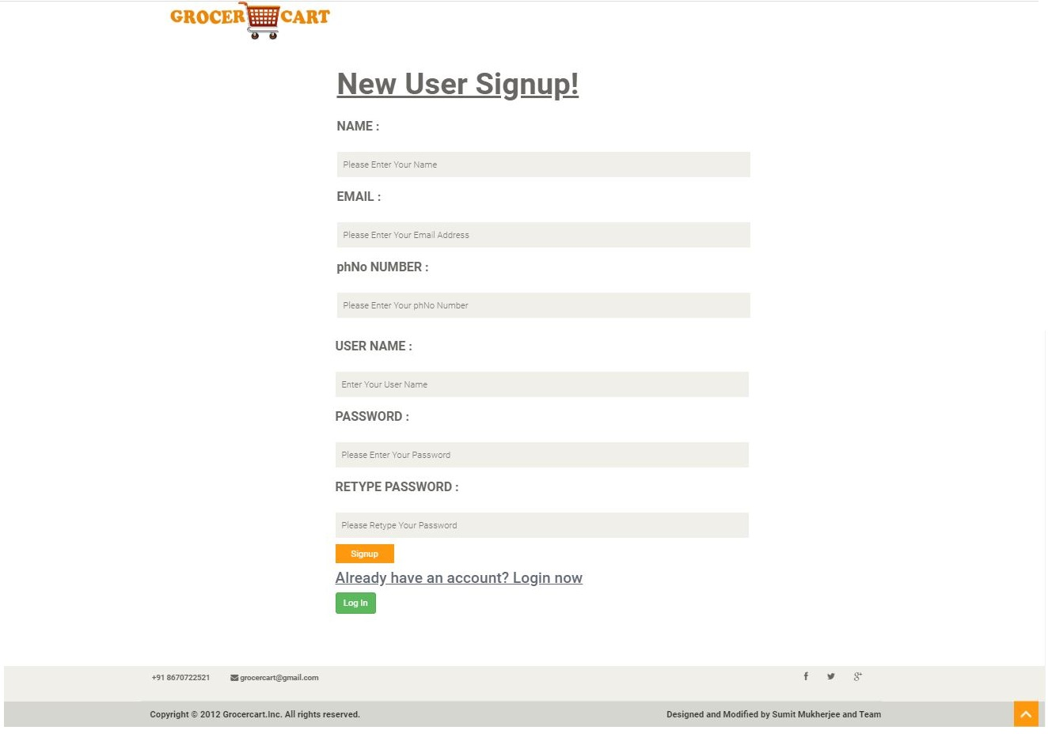

Slide 9
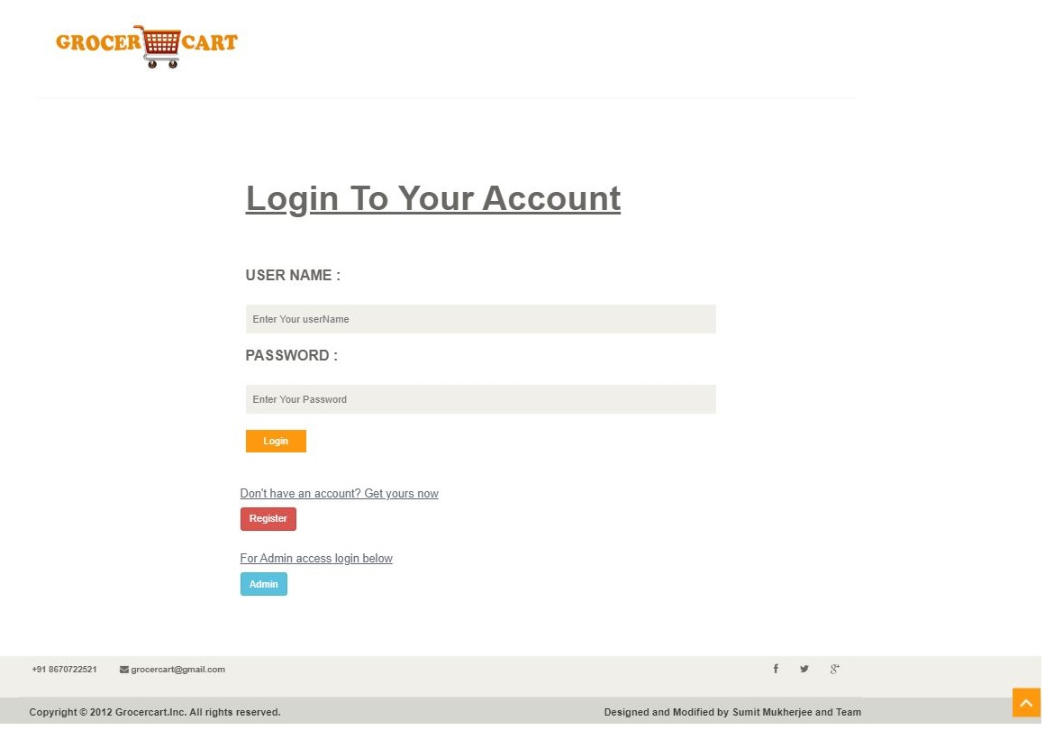

Slide 10
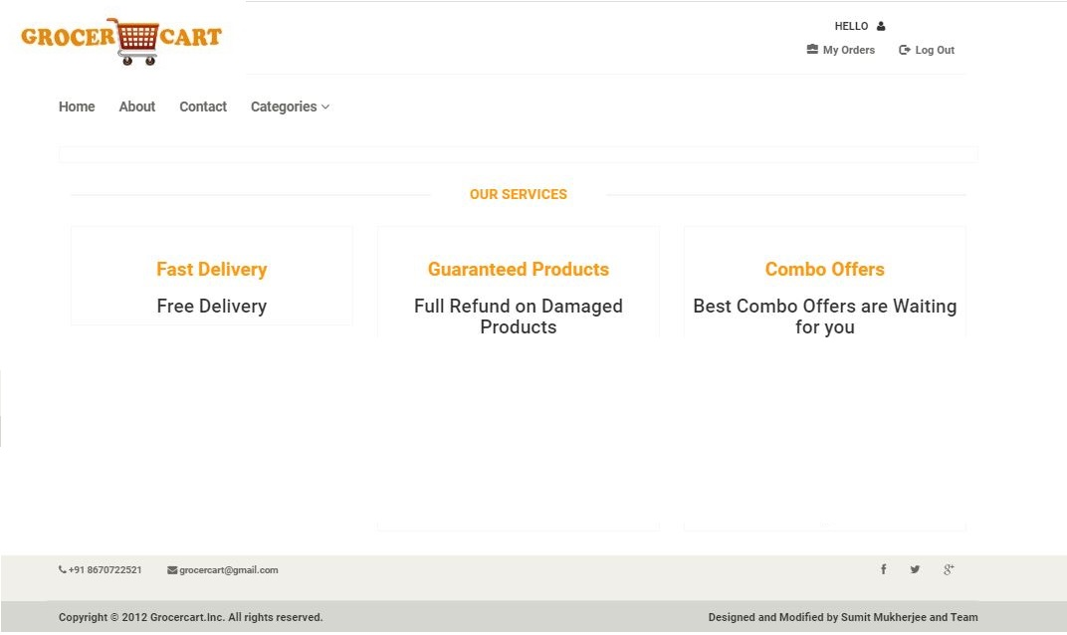

Slide 11
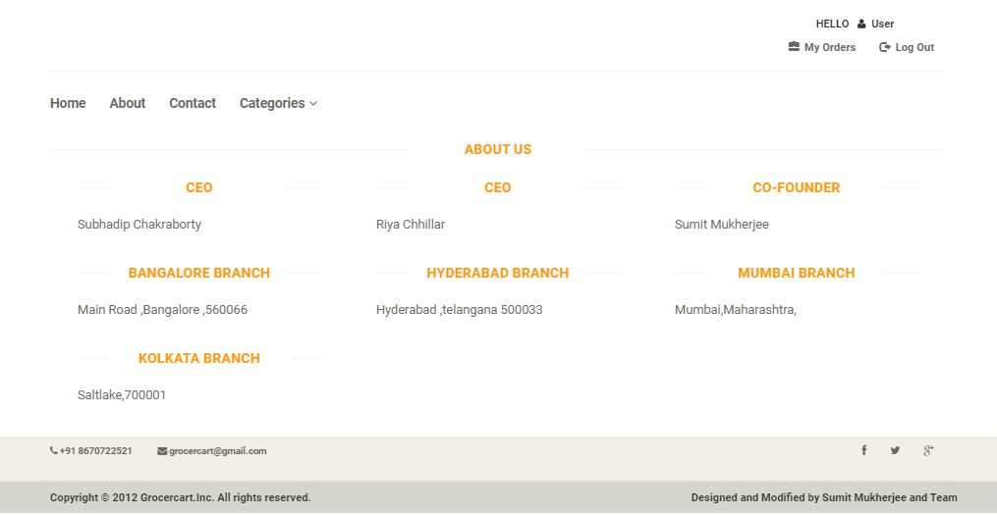

Slide 12
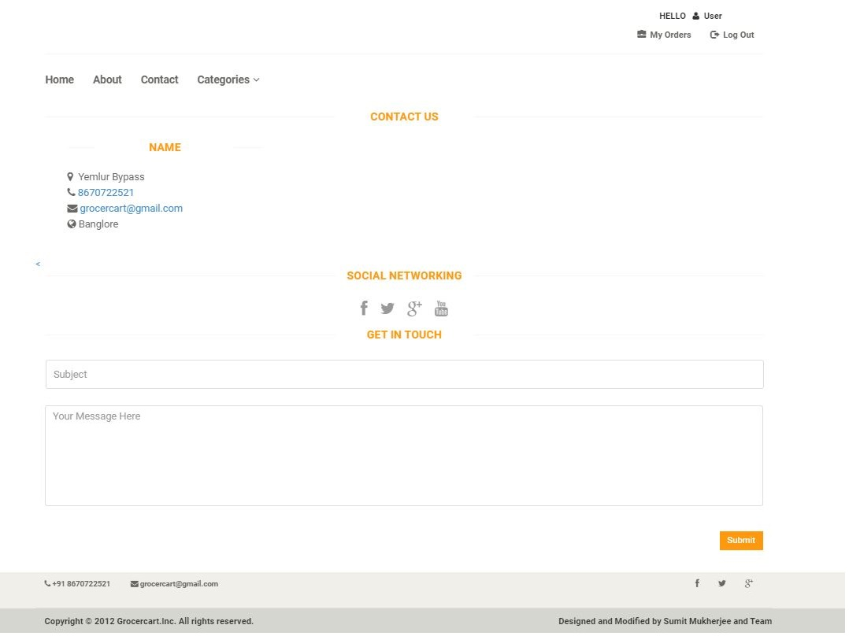

Slide 13
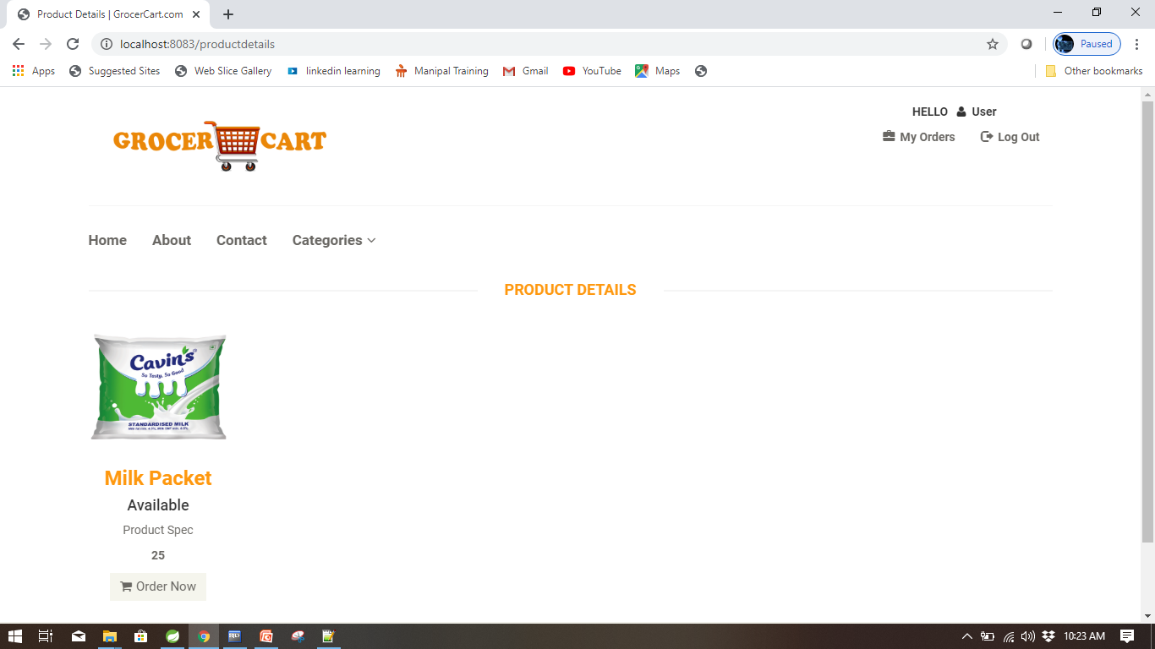

Slide 14
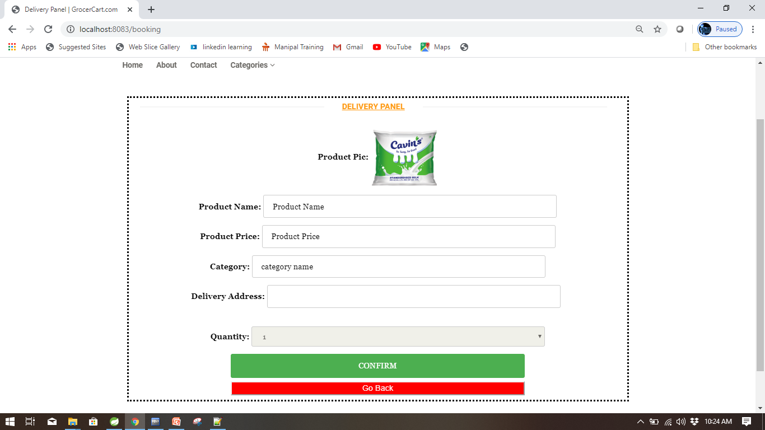

Slide 15
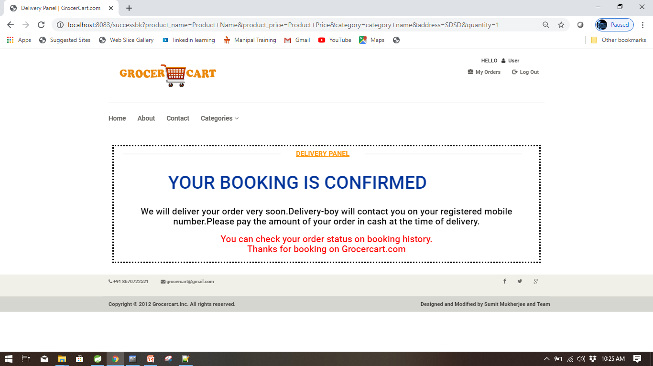

Slide 16
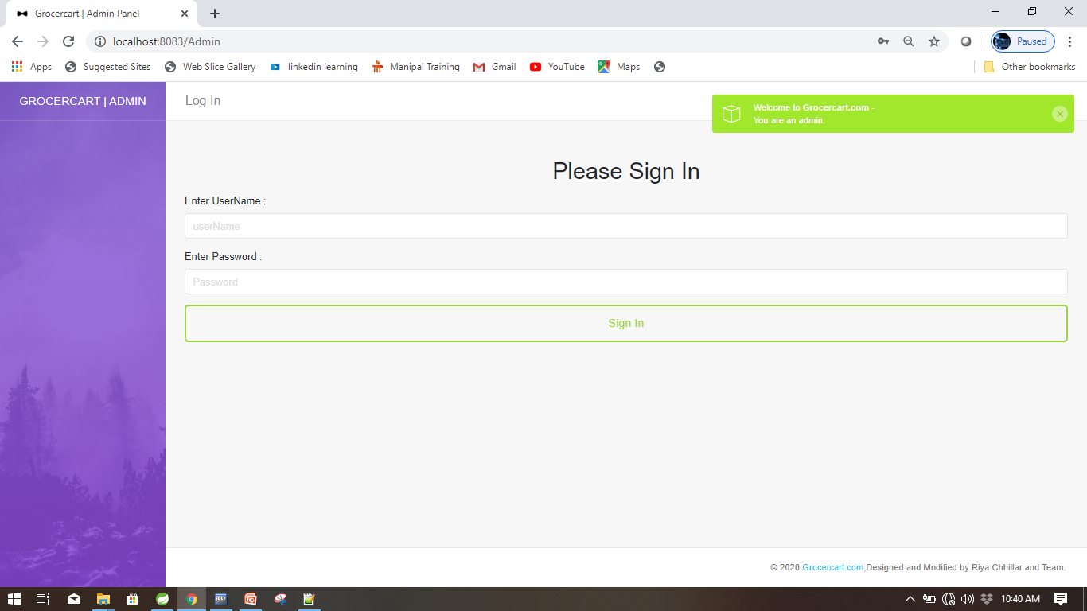

Slide 17
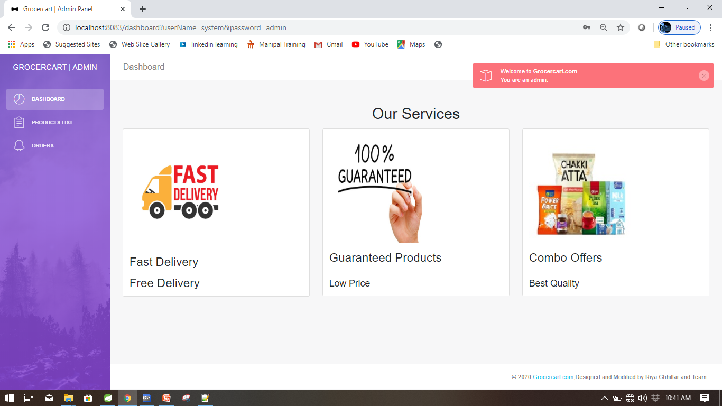

Slide 18
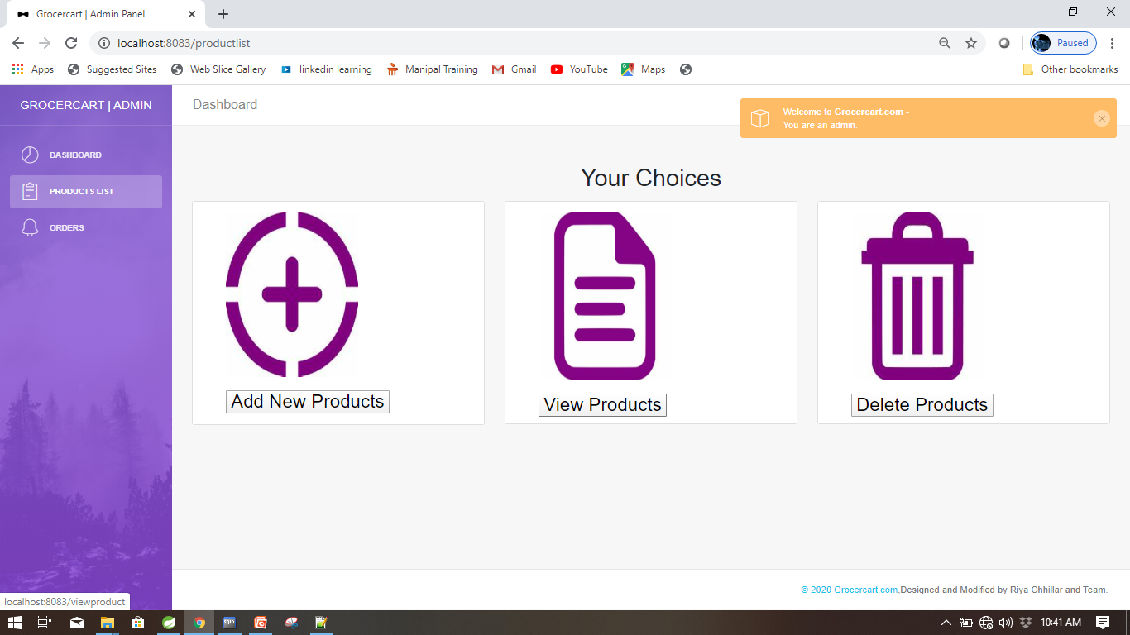

Slide 19
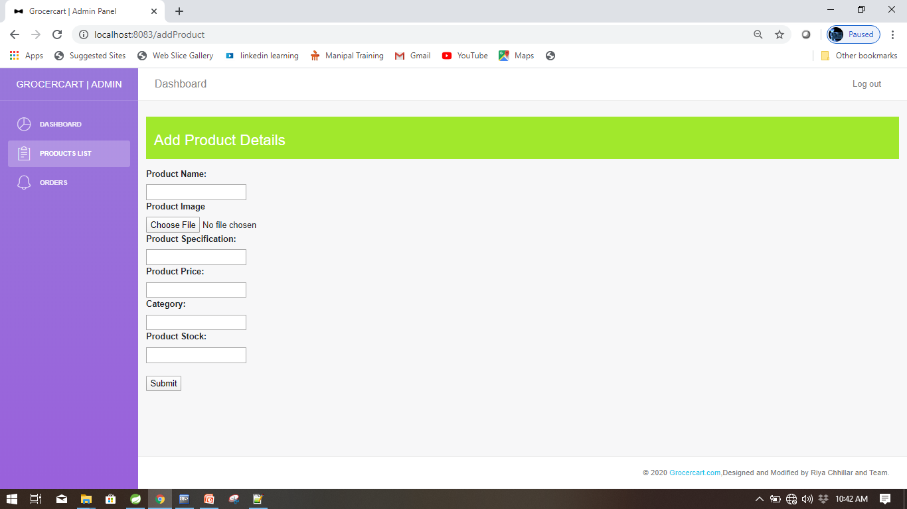

Slide 20
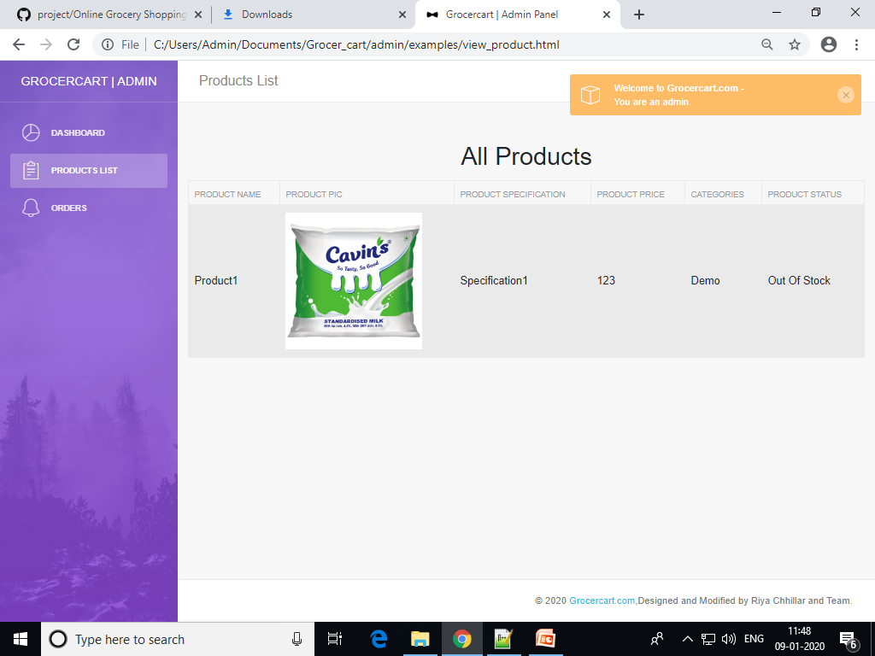

Slide 21
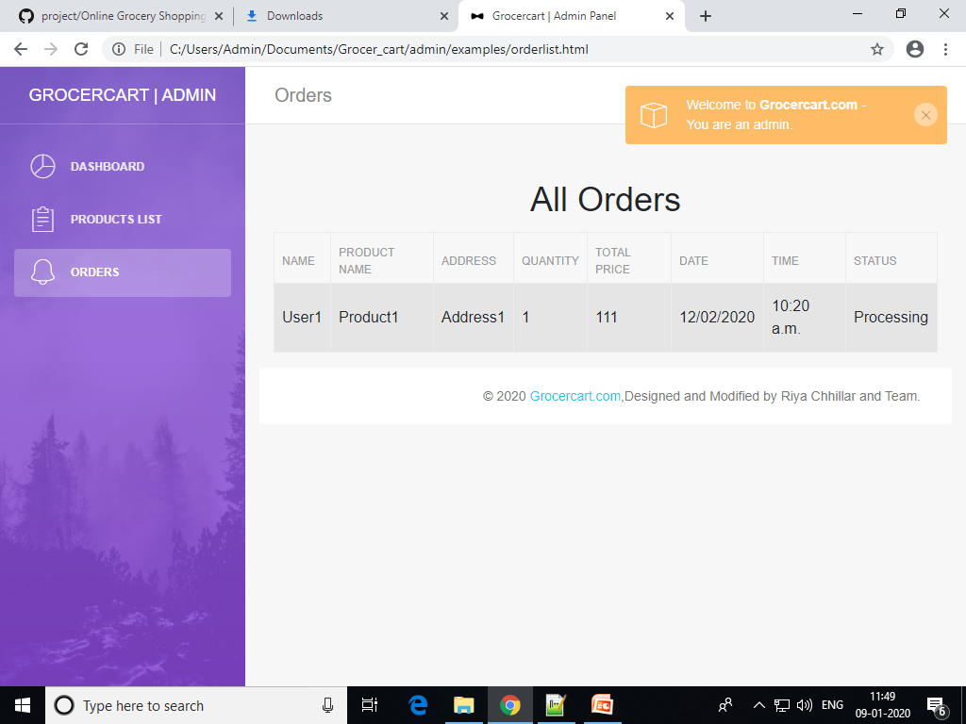

Slide 22
Application of The Project
Convenient
Range of choices
Timesaving
Affordable

Slide 23
Future Scope
Following are the features that are to be added in the future :
Online payment Gateway
Cart Facilities
Live order tracking
OTP Verification

Slide 24
Conclusion
Despite the nation’s grocery market size and its online potential, only 1% of groceries are bought online. It tells us e-grocery stores have not attained their potential. We are just in the initial stage waiting for a push that leads to success.
Marketers are often interested in attracting not just brand users, but perhaps more importantly, those who consistently purchase the company’s brand. In the context of retailing, this means identifying and attracting regular visitors and buyers at a retail store.
One Stop Shopping, which focuses on the availability of different popular brands, good quality store and availability of several products under one roof ensures that the modern consumer can shop at the same store and not move around several stores to buy merchandise.
GrocerCart.com
Spend For Quality

Slide 25
THANK YOU

